Slide 1

Charging Infrastructures for EVs and Fuel prices in France
Presented by
Prabhu Nithin Gollapudi
Masters in AI - 23269243

Slide 2
Table of Contents
Introduction
Data
Data Pipeline
Analysis
Results
Future work and Limitations

Slide 3
Introduction
Is the fuel price in France affecting the number of charging stations for electric vehicles ?
We already know that fuel prices are one of the driving factors for the adaptation of electric vehicles but is it also affecting the number of charging stations ?

Slide 4
Data
The data is maintained by the French government
Data format – Structured CSV
Data quality - Accuracy - High, Completeness - Low, Consistency - High, Timeliness - Medium, Relevance – Medium
Data License – Open License
Data info - ev station and start dates, Fuel prices – fuel price, data and fuel type

Slide 5
Data Pipeline
Extract
Python requests module to extract the data
Transform
Remove columns
Rename columns
Apply data formats to columns
Load
Save the two data sets to separate sqlite files

Slide 6
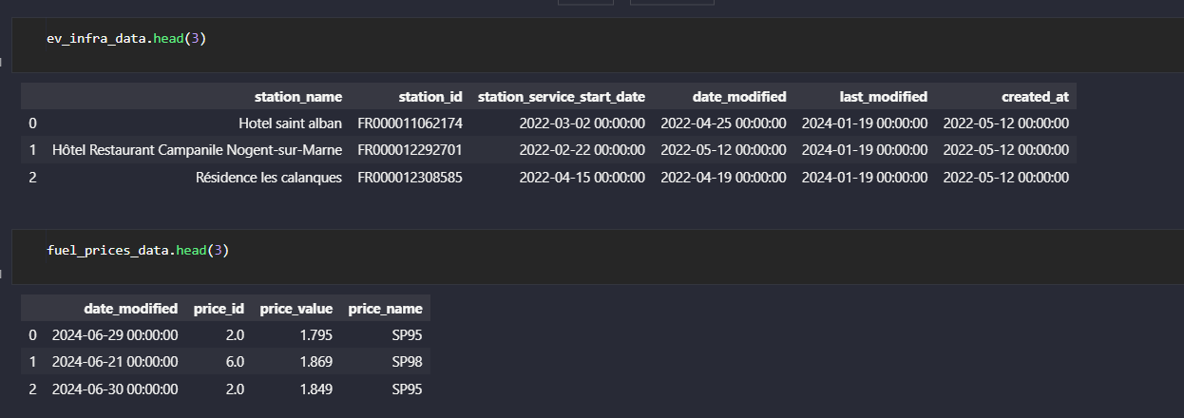
Data pipeline

Slide 7
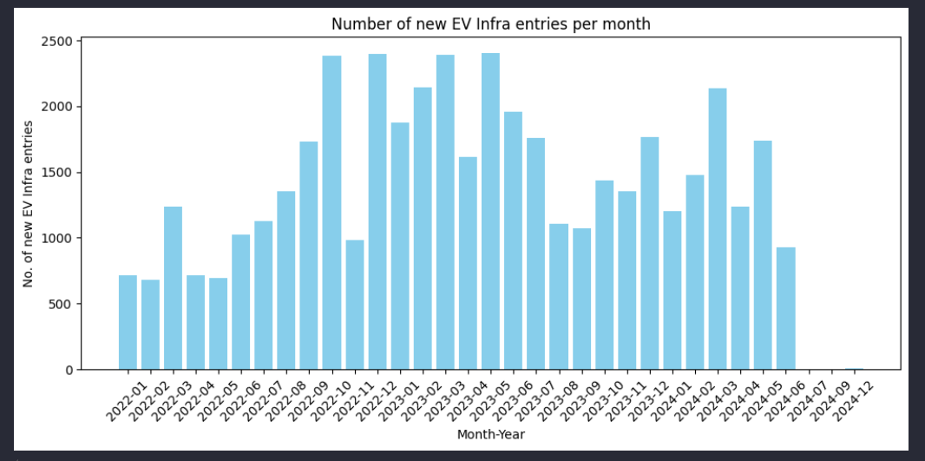
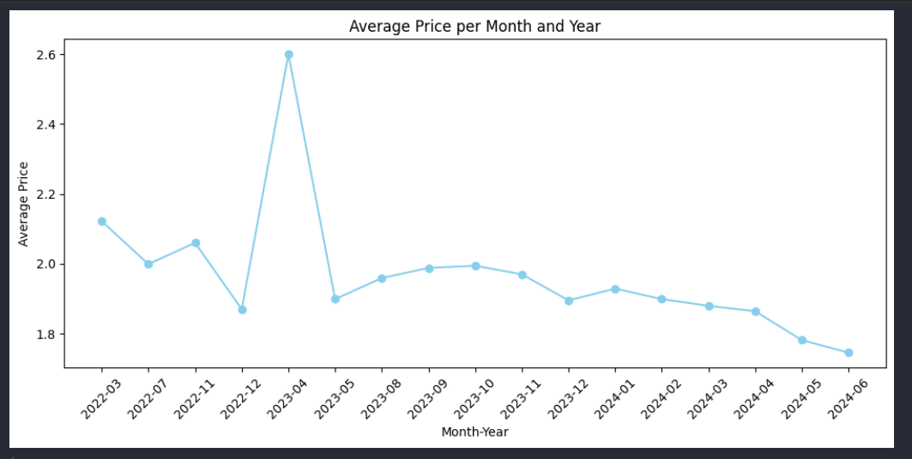
Analysis
Merge the two data sets based on time periods as two are in very different time frames.
Hence the time period is restricted from years 2022-2024

Slide 8
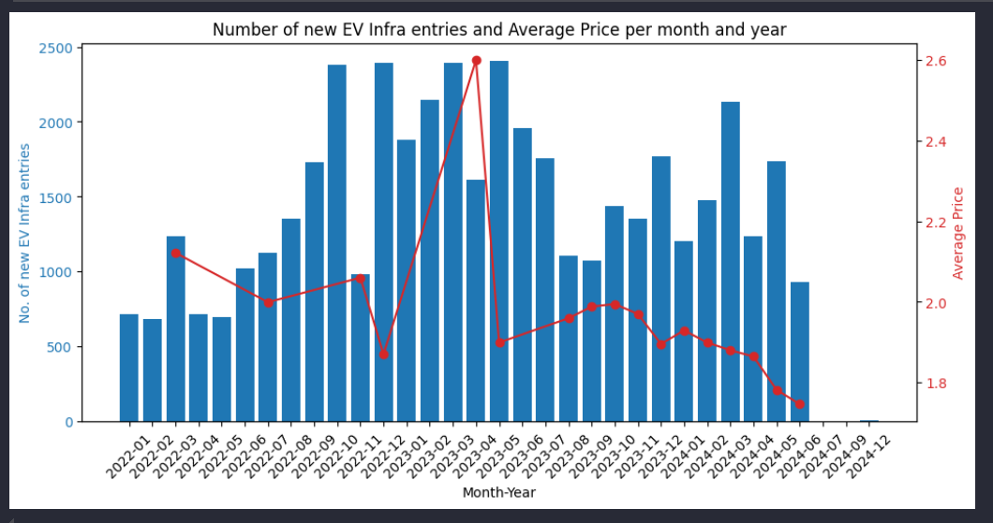
Analysis

Slide 9

Result
Although it may appear that at some point the trend is similar, the correlation between the fuel prices and the number of charging stations is very low. Therefore, we can conclude that the fuel prices are not affecting the number of charging stations in France.

Slide 10
Future work and Limitations
It is important to note that correlation does not imply causation. Therefore, we cannot say that the fuel prices are affecting the number of charging stations in France. Further research is needed to establish a causal relationship between the fuel prices and the number of charging stations in France.
In the future, we can try to analyze the relationship between the fuel prices and the number of charging stations in other countries as well. This will help us to understand if the relationship is the same in other countries as well. We can also try to extend the time frame from 2022 - 2024 to a longer period to see if the relationship holds over a longer period.

